Slide 1
DATABASE IN PROGRAMMING

Slide 2
Operators Content :
What is database
WHY WE USE database
Types of databases in programming language
Conclusion

Slide 3

WHAT IS DATABASE
A database is a structured collection of data that is organized in a way to facilitate efficient data storage, retrieval, and management. It is designed to store, manage, and manipulate data in various forms, making it easy to access, update, and analyze information.

Slide 4
WHY WE USE DATABASE
Data Organization
Data Retrieval
Security
Backup and Recovery
Data Analysis
Efficient Storage

Slide 5
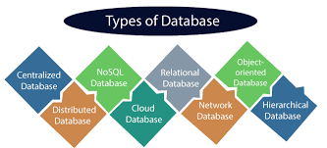
TYPES OF DATABASES
My sql
Sql
NoSQL
MongoDB
Cassandra etc.

Slide 6
CONCLUSION:
In conclusion, databases are fundamental tools in modern information management. They provide a structured and efficient way to store, retrieve, and manage data, offering numerous benefits such as improved data organization, security, scalability, and support for data analysis. Businesses and organizations across various industries rely on databases to handle their data needs effectively, ensuring data accuracy, accessibility, and security. As technology continues to evolve, databases remain a cornerstone of data management, enabling us to harness the power of data for better decision-making and innovation.

